Slide 1
What can learn from the paleoclimate record?
Lessons from the Pleistocene (3 million years back)
Lessons from the Eocene (55 million years back)

Slide 2
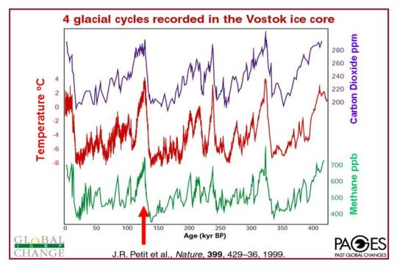


Remember the big lesson from the Pleistocene we talked about in Week 4?
During the Pleistocene, slope was a whopping $\frac{20 ℃}{290 ppm CO_{2}}$
T (relative to 1960)
Over the last 150 years, slope has been a mere $\frac{2.7 ℃}{290 ppm CO_{2}}$
Courtesy Penny Rowe
Courtesy Penny Rowe

Slide 3
Remember the big lesson from the Pleistocene we talked about in Week 4?
During the Pleistocene, slope was a whopping $\frac{20 ℃}{290 ppm CO_{2}}$
T (relative to 1960)
Over the last 150 years, slope has been a mere $\frac{2.7 ℃}{290 ppm CO_{2}}$
We should be worried about whether our models have enough feedbacks
Courtesy Penny Rowe
Courtesy Penny Rowe

Slide 4
What can learn from the paleoclimate record?
Lessons from the Pleistocene (3 million years back)
Lessons from the Eocene (55 million years back)

Slide 5
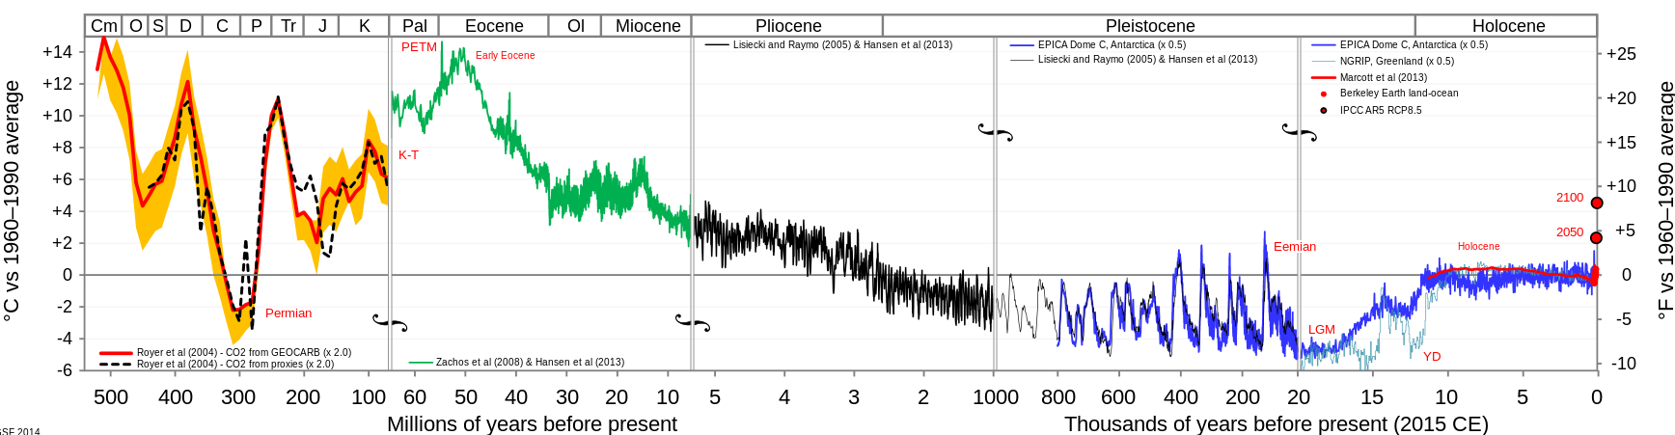
55 million years ago, we were in a “Hothouse Earth” climate
time
Hothouse Earth
Icehouse Earth

Slide 6
Then, collision of India with Asia
time
Hothouse Earth
Icehouse Earth
Collision video

Slide 7
Lowered atmospheric CO2 enabled a high-albedo, “Icehouse Earth” planet
Permanent ice formed in Greenland
time
Arctic ice persisted throughout the summer
Hothouse Earth
Icehouse Earth
Permanent ice formed in the East Antarctic

Slide 8
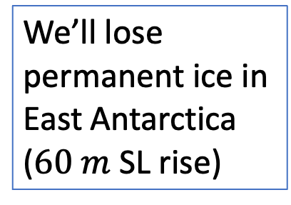

Therefore higher atmospheric CO2 will enable a low-albedo, “Hothouse Earth” planet
We’ll lose Greenland ice ($7 m$ SL rise)
time
We’ll lose summertime Arctic ice
Hothouse Earth
Icehouse Earth
We’ll lose permanent ice in East Antarctica ($60 m$ SL rise)

Slide 9
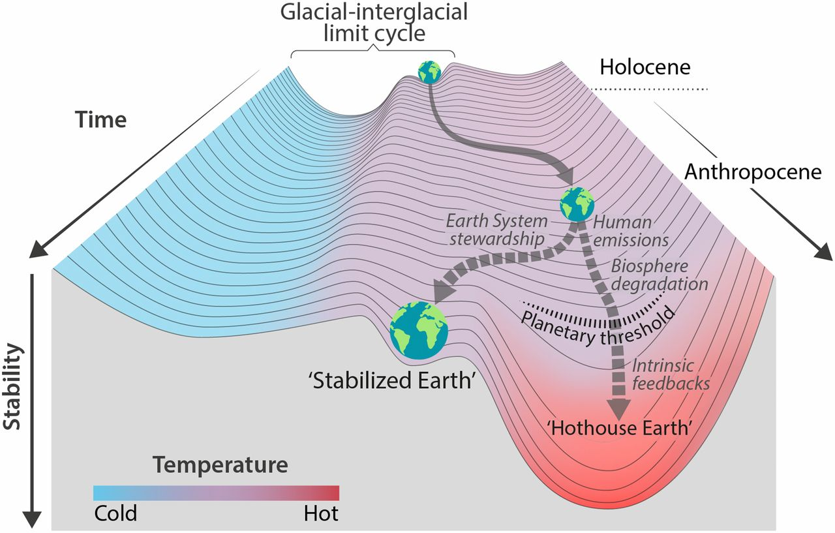
A strategy of “Earth System Stewardship” formulated in Hothouse/Icehouse terms
The warmer it gets, the more likely we slip irreversibly into “Hothouse Earth” mode.
The goal would be to bring us to a “Stabilized Earth” that looks intermediate between Icehouse and Hothouse Earth.
This week we’re investigating ice/albedo feedback (Cambio 3.0). Coming up is an investigation into the health of the terrestrial CO2 feedback itself.
*
Steffen et al, PNAS 2018: https://www.pnas.org/content/115/33/8252

